Slide 1
Put databases under source control
Alessandro Alpi

Slide 2










Sponsor & Media Partners

Slide 3

Organizers

Slide 4
About me
MVP
MCTS
MCITP
MCP
MCT
Ita blog: http://blogs.dotnethell.it/suxstellino
Eng blog: http://suxstellino.wordpress.com
Twitter: @suxstellino
Linkedin: it.linkedin.com/in/suxstellino/

Slide 5
Agenda
ALM concepts
Source control manager
Database vs Code
Database tools
Project options
Project options management tools
Conclusions
Q&A

Slide 6
ALM definition
ALM is the product lifecycle management (governance, development, and maintenance) of application software. It encompasses requirements management, software architecture, computer programming, software testing, software maintenance, change management, project management, and release management.
(source Wikipedia)

Slide 7
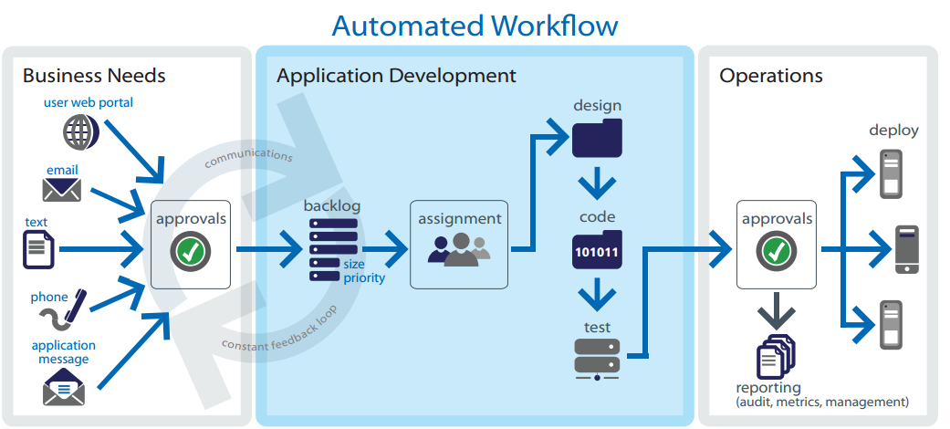
ALM workflow

Slide 8
Why ALM?
Breaking the team barriers (integration)
Release high quality software
Release software in quickly
Customer satisfaction
Improved work organization
Monitoring and tracking the activities
Improved code (clear and easy to read)

Slide 9
ALM and database
The database needs analysis and development
The databases must be redistributed
The databases must be synchronized within the development environment
The database will have «changes» associated to «activities»
The database should be tested
And, of course, it’s a good thing to deploy ☺

Slide 10
Solutions and tools – development
Management Studio – not enough
Visual Studio + Data Tools
Third party add-ons with SSMS (i.e. Red-Gate SQL Source Control)
Third party stand-alone tools

Slide 11
Source Control Manager
Management of versions
Changes of the code (and not only those)
Shared entity during development stages,
Deploy and team management
Provides an interface (also graphic)

Slide 12
SCM – Why?
Versions of our code
Safe storage of our files
Share development lines within the team
Creation of a central point for deploying
Automate build and test processes
The real needs of every team..

Slide 13
SCM – Talking about database
DB can be a file «inside the application»
DB is «located on the server»
DB persists user data
DB is not all and only code
However the changes on DB must be reflected on the whole team
The Source Control seems «uncomfortable»

Slide 14
But without a SCM
How can we easily manage the fix?
How can we prevent regressions?
How quickly can we have multiple development environments?
How can we easily create a new dev branch?
How to create different versions of the DB?
How can we synchronize the DB with the latest application changes?

Slide 15
DB vs. code – so different?
The database IS code (programmability, ddl, grant, etc.)
The «domain» tables are like many enums (static data).
The DB should be changed in more development branches.

Slide 16
DB vs. code – so different?
The pointers to the linked servers are configurations (as ‘app.config’)
The login server are environment configurations
The database persist the data. It’s not a *source control* problem

Slide 17
Why put the DB under SCM
Make versions of our objects (DDL) and our programmability on database
Make labels including the database, so we can return to a previous situation
Team synchronized to the get of the version (usually the latest)
To do versioning also of the static data

Slide 18
And more..
Continuous Integration (tests)
Branch (more development lines)
Isolated environments for geographically located teams
Atomicity between application and DB
Saving documentation of the DB

Slide 19
SCM – Here are some
TFS (on-premises and «service»)
Git
Mercurial
Subversion
CVS
Perforce
…

Slide 20
Management Tool for SCM - DB
Visual Studio
SQL Server Data Tools
Red-Gate Source Control
SQL Test (for CI)
ApexSQL Versions
…

Slide 21
Possible actions with SCM
Some actions are:
Get
Commit/Checkin
Undo
Save (working folder)
Delete (working folder)
Edit (working folder)

Slide 22
DEMO
Connect to TFService via VS Team Explorer and Red-Gate Source Control

Slide 23
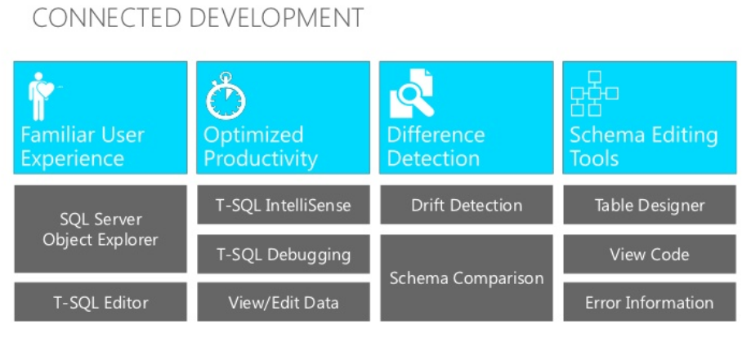
Visual Studio + Data Tools
Connected database development

Slide 24
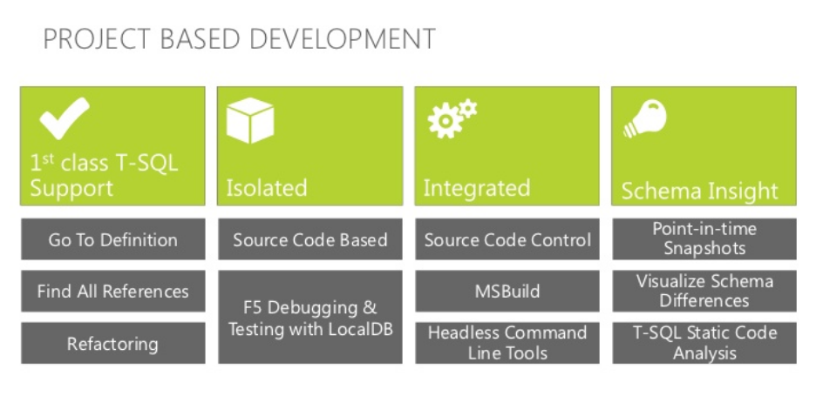
Visual Studio + Data Tools
Project based development

Slide 25
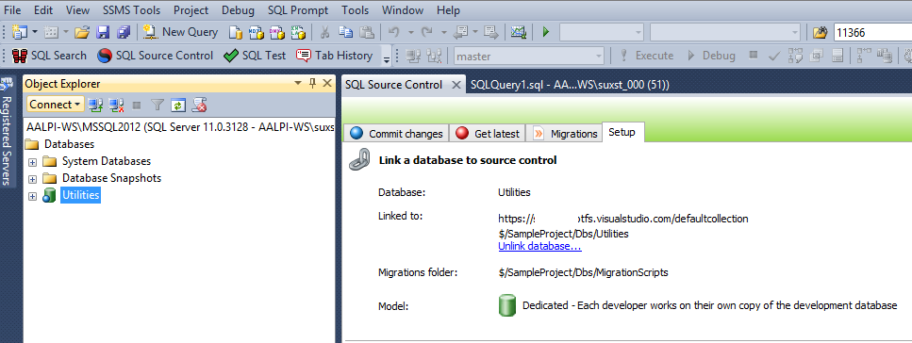
Red-Gate SQL Source Control
Integration with SQL Server Management Studio

Slide 26
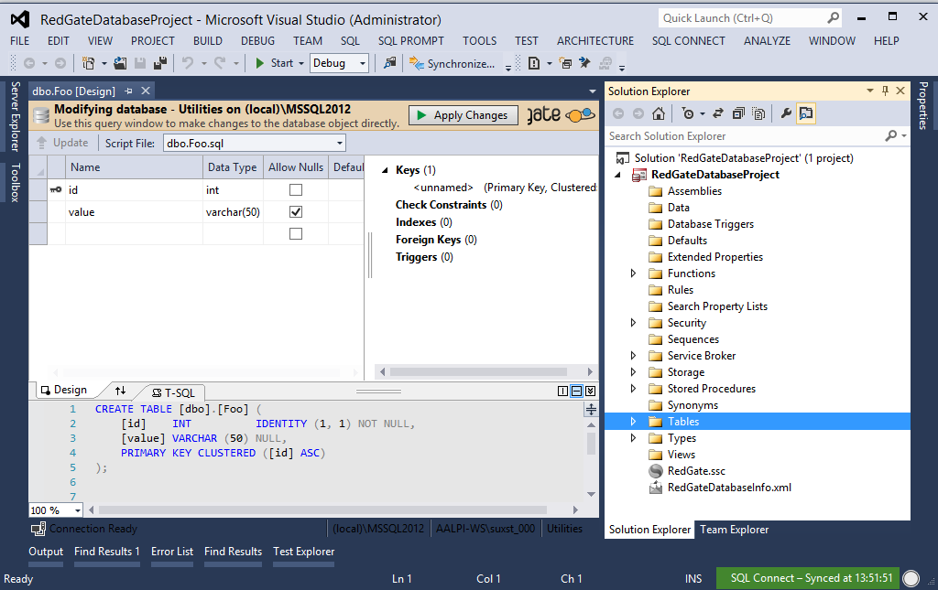
Red-Gate SQL Source Control
Integration with Visual Studio (SQLConnect)

Slide 27
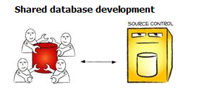
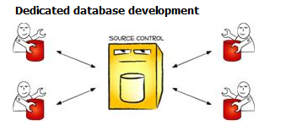
Red-Gate SQL Source Control
Shared development model
Dedicated development model (recommended)

Slide 28
Possible operations from SCM
With SQL Source Control is also possible to:
Connect to a working folder
Uses the Team Explorer of Visual Studio
Connect directly to SCM
All is directly managed from Management Studio
Save static data under source control
Automate the refactor with migration process

Slide 29
The Team Explorer
Regardless of the tool we use, Team Exploder allows us to:
Improve management of the changesets
Improve association of changesets to tasks
Improve control on commit and checkin phases
Centralize management of checkin policy
Single point for management of the team project

Slide 30
DEMO
Manage a database and a team project using TFService and the tools to manage the SCM

Slide 31
Conclusions
Which tools to use?
Every tool has its own peculiarity
SQL Source Control allows us to manage data in the easiest way
Visual Studio ensures the same structure of the database project
Visual Studio is more simple for the developers (or SQL Connect)
Which parameters should we consider?
How is our team structured?
Which are the minimum requirements?
How much can I afford to spend?
Can I afford the learning curve if I change IDE?
Last but not least, I should use the Source Control ☺

Slide 32
Resources
http://www.getlatestversion.it/ (ALM italian community)
http://blog.knodev.com/search/label/ALM (Davide Vernole’s blog on ALM)
http://www.codewrecks.com/blog/ (Gian Maria Ricci’s blog on ALM)
http://mattvsts.blogspot.it/ (Matteo Emili’s blog on ALM)
http://www.codinghorror.com/blog/2006/12/is-your-database-under-version-control.html
http://odetocode.com/blogs/scott/archive/2008/01/30/three-rules-for-database-work.aspx
http://odetocode.com/blogs/scott/archive/2008/01/31/versioning-databases-the-baseline.aspx
http://odetocode.com/blogs/scott/archive/2008/02/02/versioning-databases-change-scripts.aspx
http://odetocode.com/blogs/scott/archive/2008/02/02/versioning-databases-views-stored-procedures-and-the-like.aspx
http://odetocode.com/blogs/scott/archive/2008/02/03/versioning-databases-branching-and-merging.aspx
http://www.red-gate.com/products/sql-development/sql-source-control/
http://vsaralmassessment.codeplex.com
http://it.wikipedia.org/wiki/Application_lifecycle_management

Slide 33
Q&A
Questions?

Slide 34

Thanks!
#sqlsat257 #sqlsatverona

